Slide 1
Chapter 9
XVAs

Slide 2
CVA
Credit valuation adjustment (CVA) is an adjustment to the no-default value of derivatives arising from the possibility of a counterparty default

Slide 3
Netting
Master agreements for bilaterally cleared transactions typically state that outstanding transactions are netted in the event of a default. For example, if there are two outstanding transactions worth +10 and -6 with a counterparty the potential loss in the event of default (assuming no collateral) is 4 not 10.
This means that CVA must be calculated on a counterparty-by-counterparty basis, not on a transaction-by-transaction basis.

Slide 4

DVA
Debit (or debt) valuation adjustment is an adjustment to a bank’s no-default value because the bank itself might default.
The banks DVA is the counterparty’s CVA
Like CVA, DVA must be calculated on a counterparty-by-counterparty basis

Slide 5
Valuing Bilaterally Cleared Derivatives Portfolios continued
Value after credit adjustments is:
No-default value − CVA + DVA
CVA and DVA adjustments should reflect collateral arrangements
Why does DVA increase the value of the portfolio of transactions with the counterparty?

Slide 6
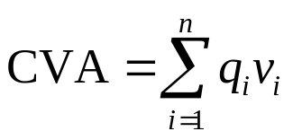
The CVA Calculation
………………
Time
0
t₁
t₂
t₃
t₄
t_{n}=T
………………
Counterparty default probability
q₁
q₂
q₃
q₄
q_{n}
………………
PV of dealer’s loss given default
v₁
v₂
v₃
v₄
v_{n}

Slide 7
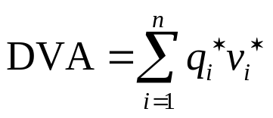
The DVA Calculation
………………
Time
0
t₁
t₂
t₃
t₄
t_{n}=T
………………
Dealer default probability
q₁*
q₂*
q₃*
q₄*
q_{n}*
………………
PV of counterparty’s loss given default
v₁*
v₂*
v₃*
v₄*
v_{n}*

Slide 8
FVA and MVA (Figure 9.1)
Consider the situation where a bank enters into a transaction with an end user where no margin is posted and hedges this by entering into an offsetting transaction with another bank:
Corporate
End User
2.9%
Bank A
3.0%
Bank B
LIBOR
LIBOR

Slide 9
FVA and MVA continued
FVA is the expected cost of the incremental variation margin on the hedge transaction
MVA is the expected cost of the incremental initial margin on the hedge transaction

Slide 10
The Cost
Many banks use their average debt funding cost to calculate the cost of FVA and MVA
Financial economic theory would suggest that the initial margin and variation margin are low risk investments. The required return is less than the bank’s average funding cost
If the return required on margin is the fed funds rate plus 10 bps and the interest earned on margin is the fed funds rate minus 20 basis points, the funding cost (possibly a benefit in the case of FVA) is 30bps

Slide 11
KVA
KVA is the capital valuation adjustment.
This is an adjustment for the incremental capital requirements associated with a derivative
Many banks consider the cost of incremental capital to be the required return on equity
Financial economists would argue that additional equity makes the bank less risky and should reduce the required return on both debt and equity

Slide 12
Calculation Issues
The calculation of all the XVAs involve very time-consuming Monte Carlo simulations.
This is because it is necessary to calculate
  expected future exposures for both bank and counterparty (in the case of CVA and DVA)
  expected future variation and initial margin requirements (in the case of FVA and MVA)
  expected future capital requirements (in the case of KVA)

